Slide 1
Searching: Linear search and Binary search

Slide 2
Searching algorithm
Searching algorithms are used to locate specific data within a larger set of data. It helps find the presence of a target value within the data. There are various types of searching algorithms, each with its own approach and efficiency.

Slide 3
Linear Search
What is Linear Search Algorithm?
Linear search is a method for searching for an element in a collection of elements. In linear search, each element of the collection is visited one by one in a sequential fashion to find the desired element. Linear search is also known as sequential search.

Slide 4
Algorithm for Linear Search :
Algorithm for Linear Search Algorithm:
The algorithm for linear search can be broken down into the following steps:
Start: Begin at the first element of the collection of elements.
Compare: Compare the current element with the desired element.
Found: If the current element is equal to the desired element, return true or index to the current element.
Move: Otherwise, move to the next element in the collection.
Repeat: Repeat steps 2-4 until we have reached the end of collection.
Not found: If the end of the collection is reached without finding the desired element, return that the desired element is not in the array.

Slide 5
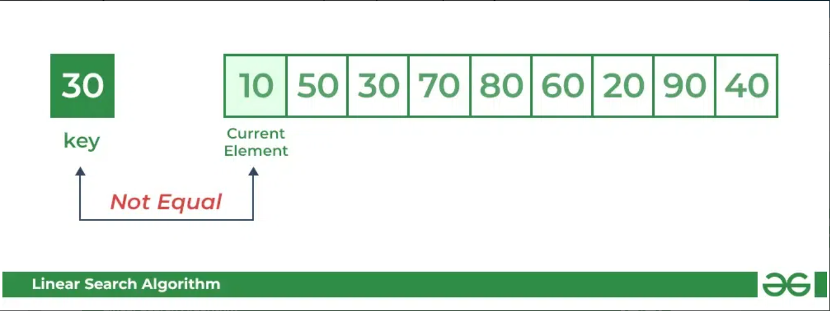
For example: Consider the array arr[] = {10, 50, 30, 70, 80, 20, 90, 40} and key = 30

Slide 6
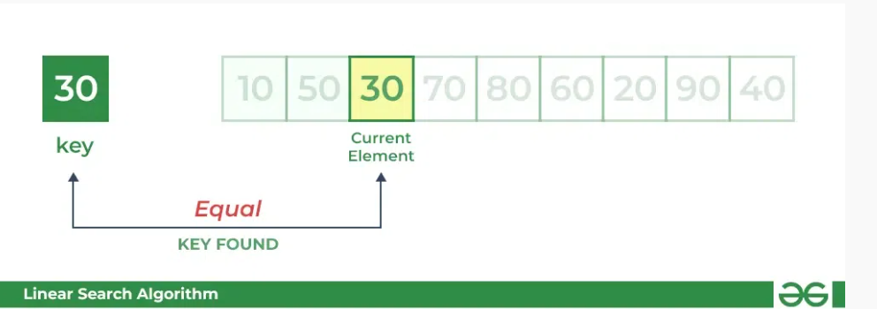
Comparing key with next element arr[1]. SInce not equal, the iterator moves to the next element as a potential match. Now when comparing arr[2] with key, the value matches. So the Linear Search Algorithm will yield a successful message and return the index of the element when key is found (here 2).

Slide 7
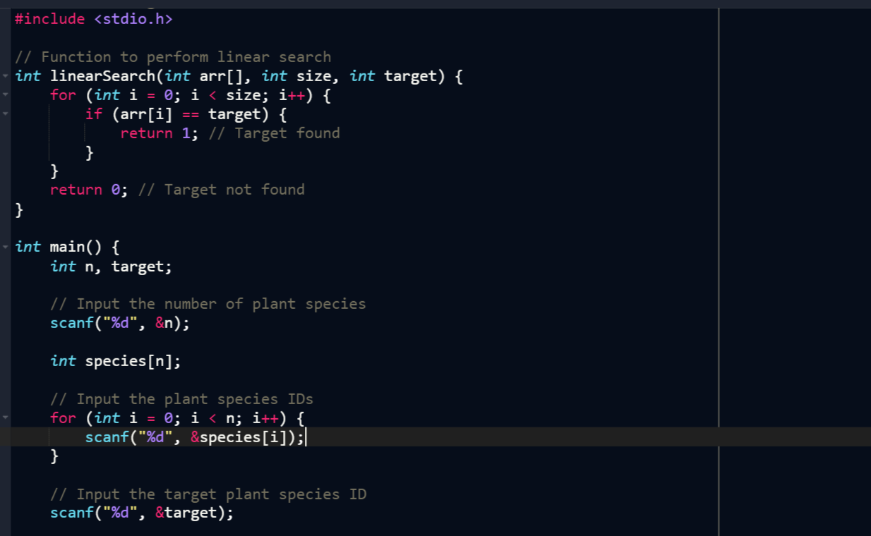
Emma has a collection of unique plant species in her garden. She wants to check if a particular plant is already in her collection. Help Emma by writing a program using a linear search algorithm that determines if the plant species is in her collection.

Slide 8
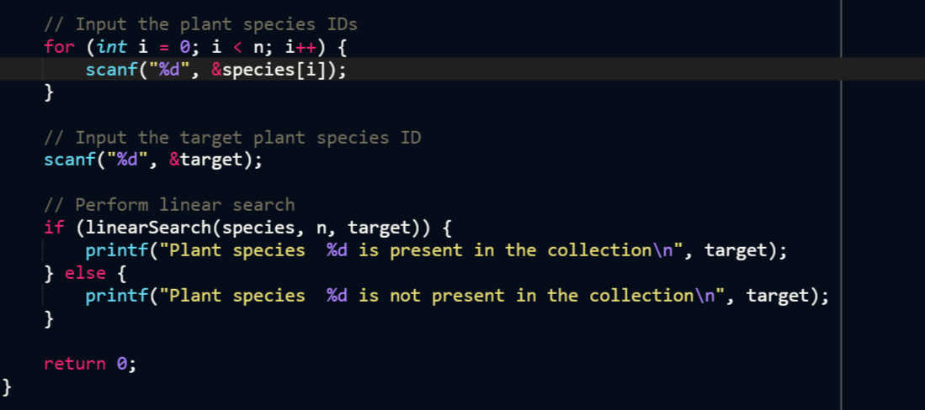
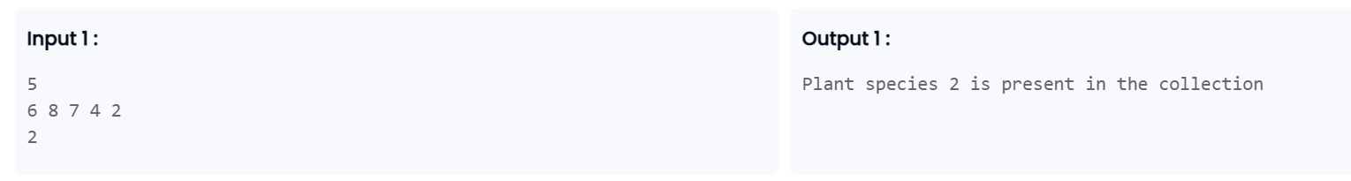

Slide 9
Time and Space complexity
Time Complexity:
Best Case: In the best case, the key might be present at the first index. So the best case complexity is O(1)
Worst Case: In the worst case, the key might be present at the last index i.e., opposite to the end from which the search has started in the list. So the worst-case complexity is O(N) where N is the size of the list.
Average Case: O(N)
Auxiliary Space: O(1) as except for the variable to iterate through the list, no other variable is used.

Slide 10
Applications of Linear Search Algorithm:
Unsorted Lists: When we have an unsorted array or list, linear search is most commonly used to find any element in the collection.
Small Data Sets: Linear Search is preferred over binary search when we have small data sets with
Searching Linked Lists: In linked list implementations, linear search is commonly used to find elements within the list. Each node is checked sequentially until the desired element is found.
Simple Implementation: Linear Search is much easier to understand and implement as compared to Binary Search or Ternary Search.

Slide 11
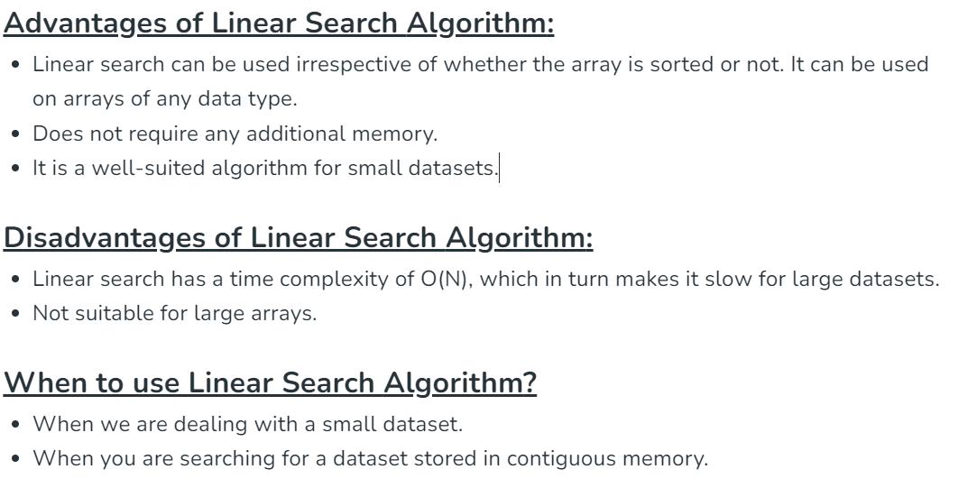

Slide 12
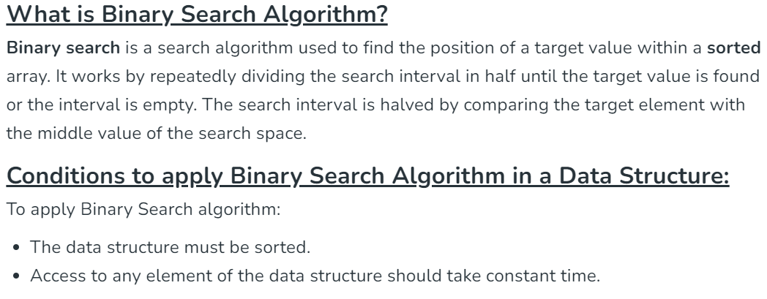
Binary Search

Slide 13
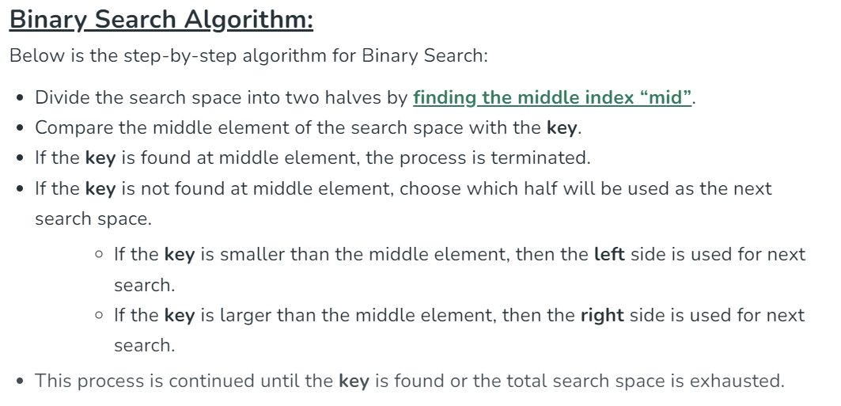

Slide 14
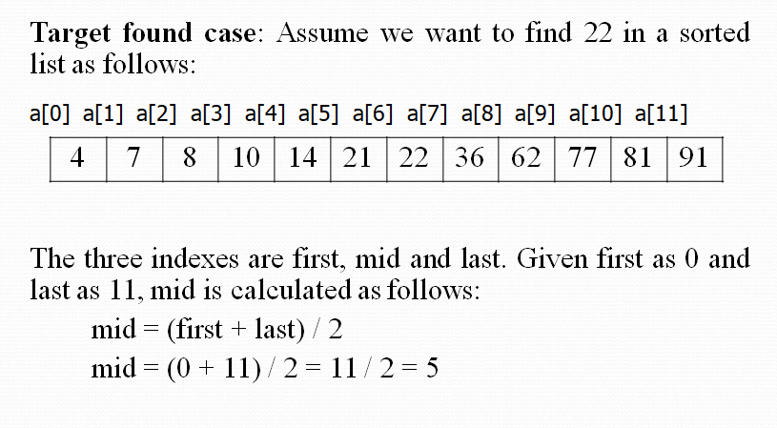
Example

Slide 15
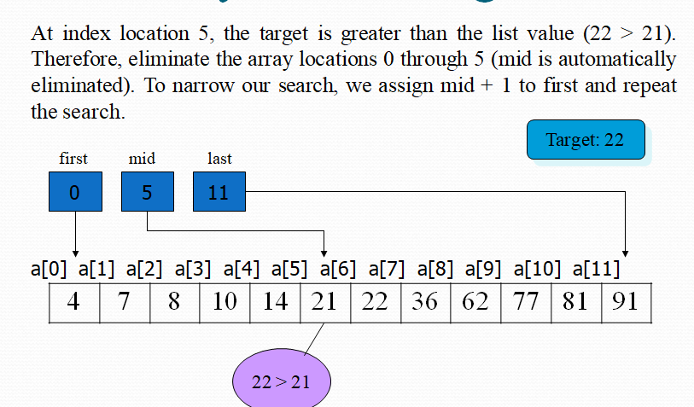

Slide 16
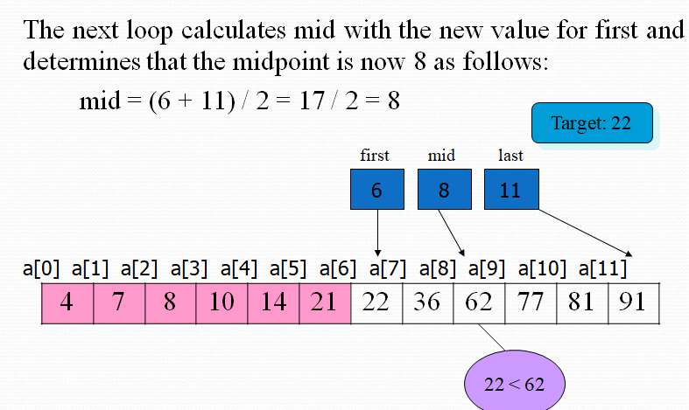

Slide 17
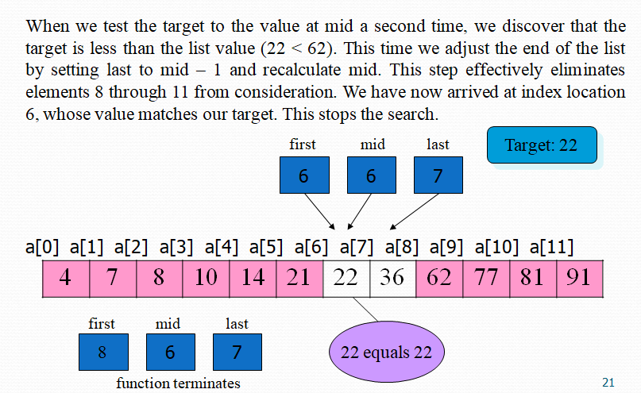

Slide 18
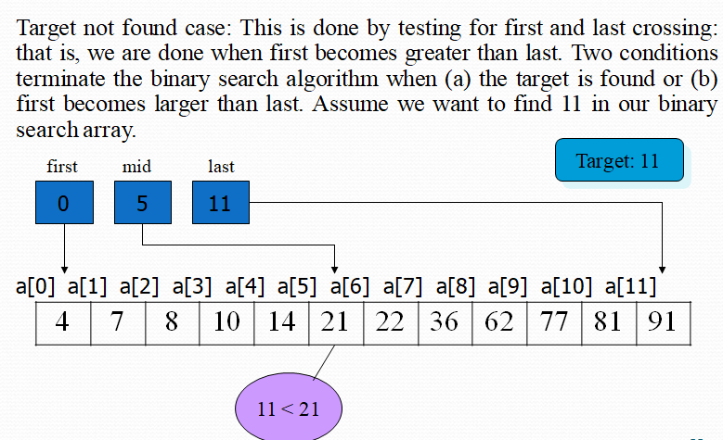

Slide 19
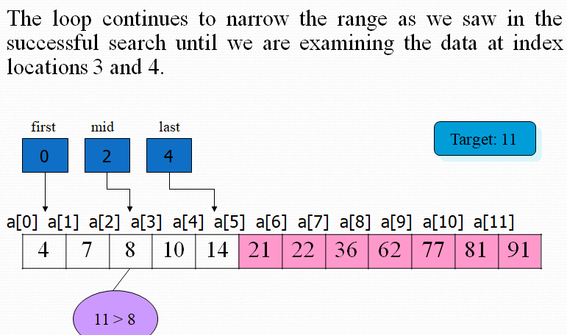

Slide 20
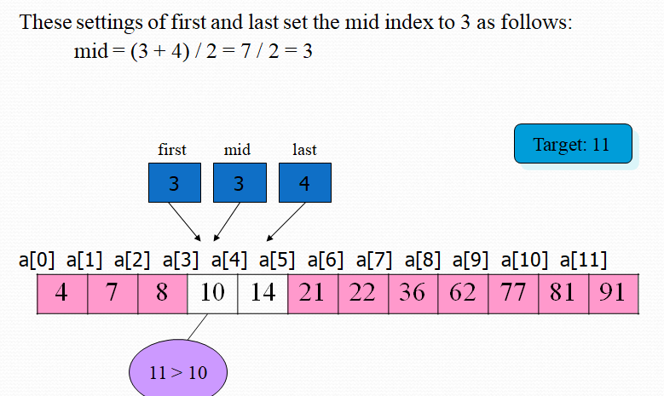

Slide 21
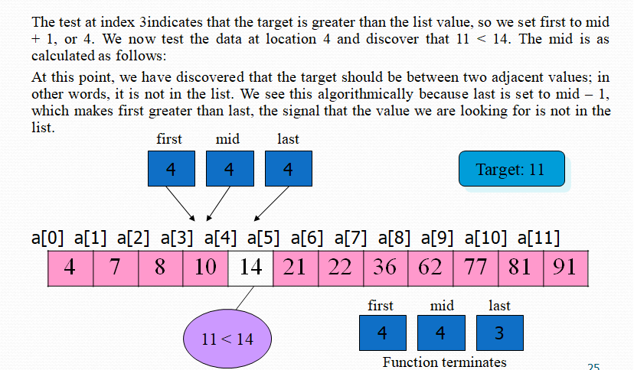

Slide 22
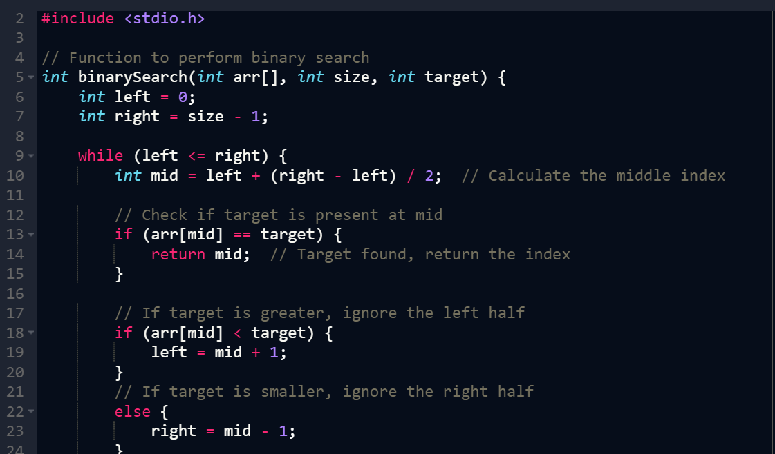
Notes:
left + (right - left) // 2 would be used to avoid integer overflow, which could happen when doing left + right .

Slide 23
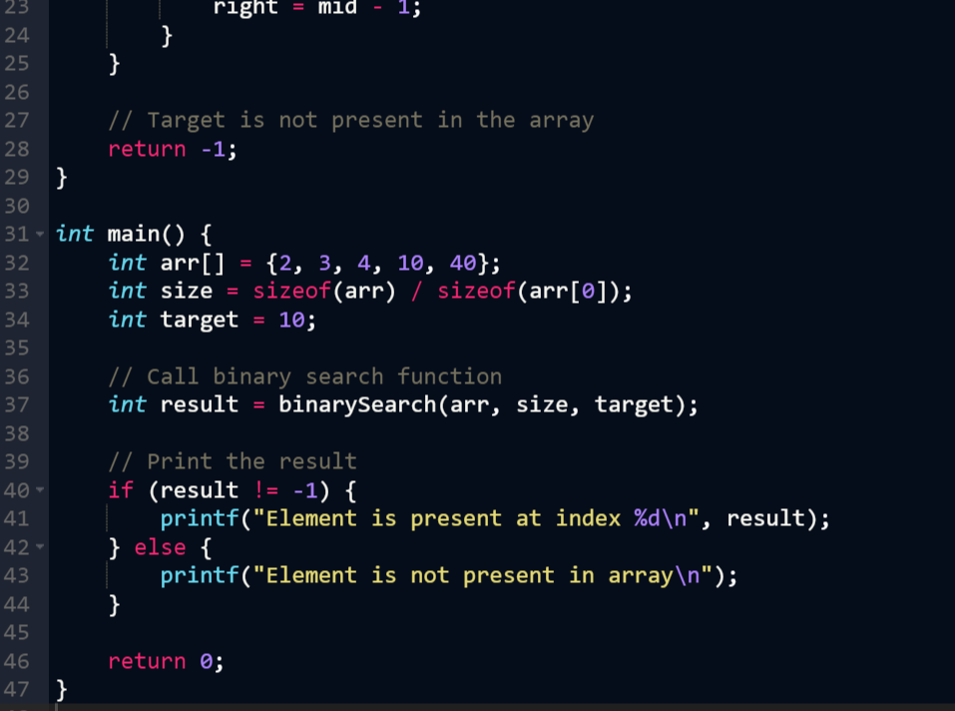

Slide 24
Time and Space complexities for Binary search
The time complexity of binary search using iteration is O(log n), where n is the number of elements in the list. This is because the algorithm reduces the search space in half with each iteration
The space complexity of binary search using iteration is O(1)
In contrast, the space complexity of binary search using recursion is O(log n). In the worst case, this is because log n recursive calls are stacked in memory

Slide 25
